Slide 1
Secure Software

Slide 2

Where Were You When the World Stopped Turning?

Slide 3
Introductions
Full name & Preferred name
60 second bio – hometown, work experience (AFSC), life outside of work, why AFIT?
Fun fact about yourself
Coding experience/ experience with secure software design & development
What’s this course about?
What are you hoping to learn?
(Research interests if you know them)

Slide 4
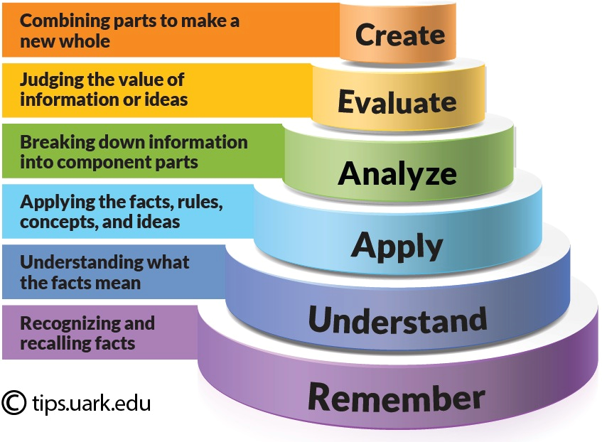
Undergraduate vs. Graduate Education
Masters/PhD - 18 months/ 3 years/ longer?
Education versus Training
How do you do research?
Critical Analysis
Independent work
Syllabus
Learning Objectives
Resources
Administrivia
Grading & Course Schedule
Bloom’s Taxonomy of Learning

Slide 5
Course Objectives
Introduce sound security principles
Study common software exploits
Understand software protection mechanisms
Understand theoretical and practical boundaries that frame study of software security

Slide 6
Course Roadmap
Theory
Based on reading/discussion of relevant journal and conference articles
24 Deadly Sins used for high-level overview and course organization
Practice
Exercises to cover and observe some important topics
Hands-on coding project
Goal
Provide an educational foundation—not a training course
*

Slide 7
Course Paradigm
Graduate Courses – for each instruction hour, 2 - 3 hours of homework
Reading Heavy – textbook plus peer reviewed articles
5 - 6 hours per week
Technically Moderate
Weeks 5 & 7 - 2 – 4 hours per week
Capstone Paper or Game – 45% of Your Grade!
Participation and Article Reviews – “Gimmee” Points (that can bite you)

Slide 8
Class Paradigm
Pre Class 1 - Read Preparatory Readings and be prepared to discuss
Class 1
Introduce Topic
Discuss Readings & Explain Topic – PowerPoint Ranger and Examples on OnlineGDB
Class Exercises – Need OnlineGDB (or something similar)
Post Class 1 – Read Critical Readings
Initial read should be 15 – 20 minutes
Additional, detailed reading based on interest
Post a SHORT summary of article including a bibliography entry in CANVAS the night before.
what’s it about? How can I use it?
Class 2
Quick recap of topic
Discuss critical reading
Continue discussion/instruction as needed

Slide 9
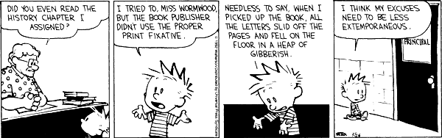
Course Grading
http://www.gocomics.com/calvinandhobbes

Slide 10
Course Grading
Participation – Discussion questions (8%)
Critical reviews (12%)
What’s it about?
Strengths & Weakesses?
How can I use it?
Code Review Project (15%)
Phase 1 – Write some code
Phase 2 – Assess someone else’s code and write up your findings
Phase 3 – Fix your code
Phase 4 – Assess whether the code now is secure of previous vulnerabilities

Slide 11
Course Grading
Mid-term (20%)
In class -- *NOT* in the middle of the quarter— Week 8 or 9
Possibly off cycle from other classes?
Easier if you keep up with self-paced material

Slide 12
Capstone Project – 2 Options
Research Paper (~65% of a conference paper)
Select topic related to software security / secure coding
Review literature associated with your area (15+ scholarly references)
Define fundamentals, identify state of the practice & art, challenges, etc
Experimentation unlikely completed in this course
If possible, further your work/ponder about a topic related to your thesis
Serious Game
Related to software security / secure coding
Still structured like a research paper, but lighter on the literature
What are the learning objectives
What are the game mechanics and how do they facilitate the learning objectives
A literature review is still required (7+ references) blending serious games and application

Slide 13
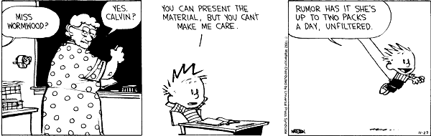
Action Item
Choose a topic by Mon, 12 Oct related to the course subject matter.
Write a short introduction – what’s your topic and why should we care?

Slide 14
Research Paper
What makes a good research paper?
Examine scholarly literature related to software security problems of interest
Look at their introductions & future work (and literature review)
Focus on a particular problem
What theory/academic knowledge bounds the problem scope?
What practical applications are in use/view?
What has been done and what is yet to be done?
What is currently possible/feasible and what problems are researchers trying to solve?
What are the interesting questions being addressed or that need to be addressed?

Slide 15
Research Paper
What makes a good research paper?
Based on the background and problem/domain:
Compare/contrast efficiency, security, generality, usability, etc.
Posit a new idea or direction/hypothesis/make an assertion
Summarize weaknesses/strengths of current approaches to better define boundary
Give a structure or frame a critical research question
Propose an extension to an existing technique/tool
Apply knowledge from other domains to domain of software protection
Conceptualize an approach to solving a problem that has not yet been solved

Slide 16
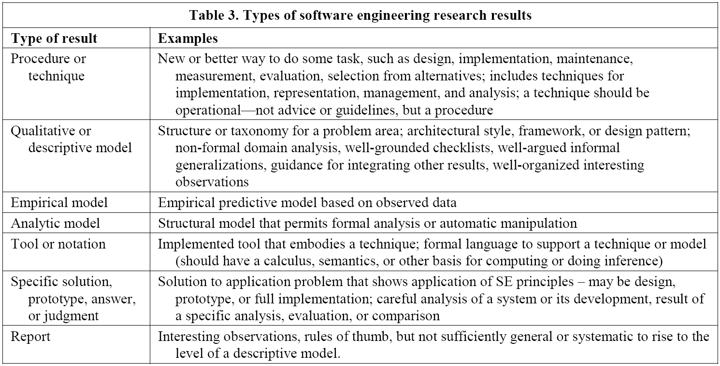
Research Paper
Shaw, M., Writing good software engineering research papers: minitutorial, Proceedings of the 25th International Conference on Software Engineering

Slide 17
What’s a game?
“A game is a system in which players engage in artificial conflict, defined by rules, that results in a quantifiable outcome.”
System – interconnected elements
Players –one or more people
Conflict – interaction between players (and/ or the game)
Rules – structure
Quantifiable Outcome – win/lose state
Abstract – representation, *not* an exact replica
Salen Tekinbas and Zimmerman, Rules of Play: Game Design Fundamentals, MIT Press, 2003.

Slide 18
What’s a game?
Is Tag a game?
What about Apples to Apples?
Is Patience/ Solitaire a game?
What about SimCity?
Is Trivial Pursuit a serious game?
What about Loco?

Slide 19
Why use games to educate?

Slide 20
Serious Game
What makes a good serious game?
Defined learning objectives (may or may not be revealed to players at outset)
Small number of game mechanics
Game mechanics tied to learning objectives
Clear rules
Play tested
Fun!
Examples will be used throughout this course
Requires additional background reading on serious games

Slide 21
Serious Game
What makes a good serious game?
A game where the lessons are learned implicitly
Learning objectives emerge from the way the mechanics combine
Simple rules, short (< 20 minutes) play time
Learning emerges as players develop and test different strategies
A game where the lessons are learned explicitly
Learning objectives are transplanted into game mechanics
Game mechanics and components are explicitly thematic
Learning can emerge through one or two plays as the players learn directly from the actions they take

